Slide 1



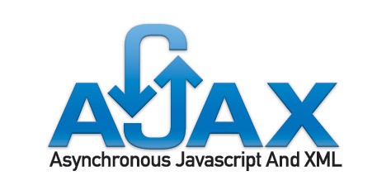
ASP.NET AJAX – Basics
Svetlin Nakov
Telerik Corporation
www.telerik.com

Slide 2


Table of Contents
What is AJAX?
AJAX Concept
ASP.NET AJAX Framework
ASP.NET AJAX Server Controls
ScriptManager, UpdatePanel
Timer, Update Progress
Triggers
ASP.NET AJAX Control Toolkit

Slide 3
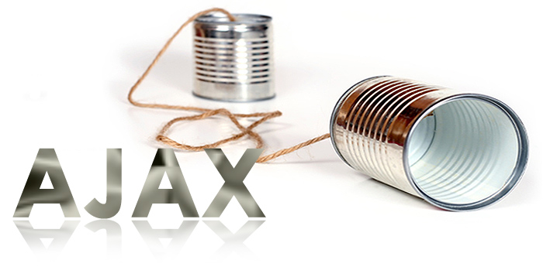
What is AJAX?

Slide 4
What is AJAX?
AJAX = Asynchronous JavaScript And XML
Allows updating parts of a Web page at runtime
Approach for developing dynamic Web sites
Not a particular technology
There are over 50 AJAX frameworks
http://www.maxkiesler.com/index.php/weblog/comments/round_up_of_50_ajax_toolkits_and_frameworks
ASP.NET AJAX is Microsoft’s AJAX framework
Part of ASP.NET and .NET Framework
Supported by Visual Studio

Slide 5
What is AJAX? (2)
AJAX enables you to pass information between a Web browser and Web server without refreshing the entire Web page
Done by asynchronous JavaScript HTTP requests and dynamic page updates
HTTP
Data
(HTML /
JSON /
XML / …)
HTTP
Client Web Browser
Server

Slide 6
AJAX Technology Components
DHTML + DOM
Browser DOM manipulated through JavaScript
Used to dynamically display and interact with the page contents
CSS stylesheets for formatting
XMLHttpRequest object
Exchange data asynchronously with the Web server through asynchronous HTTP requests
Any data format could be used: HTML fragments, text fragments, XML, JSON, etc.
6
Notes:
6
12.08.2010 12:12
©2005 Microsoft Corporation. All rights reserved.
This presentation is for informational purposes only. Microsoft makes no warranties, express or implied, in this summary.
6

Slide 7
What is ASP.NET AJAX?
ASP.NET AJAX is AJAX development framework from Microsoft
Standard part of .NET Framework
Allows quickly creating highly interactive Web applications, easy-to-use, highly productive
Supports both popular approaches:
Server-centric (partial page rendering)
Client-centric (client-side control rendering)
Works on all modern browsers: Internet Explorer, Firefox, Safari, Chrome, Opera
7
Notes:
7

Slide 8
ASP.NET AJAX Architecture
XHTML, CSS,
JavaScript,
AJAX
Markup
AJAX-enabled
ASP.NET Pages
Web Services
(ASMX or WCF)
AJAX Client Script Library
ASP.NET AJAX Server Extensions
Controls, Components
App Services Bridge
AJAX
Server Controls
Component Model and UI Framework
Asynchronous Communication
Base Class Library
Script Core Library
ASP.NET 4.0
Page Framework,
Server Controls
Application Services
Browser Compatibility
Client Framework and Services
Server Framework
8
Notes:
8
12.08.2010 12:12
©2005 Microsoft Corporation. All rights reserved.
This presentation is for informational purposes only. Microsoft makes no warranties, express or implied, in this summary.
8

Slide 9
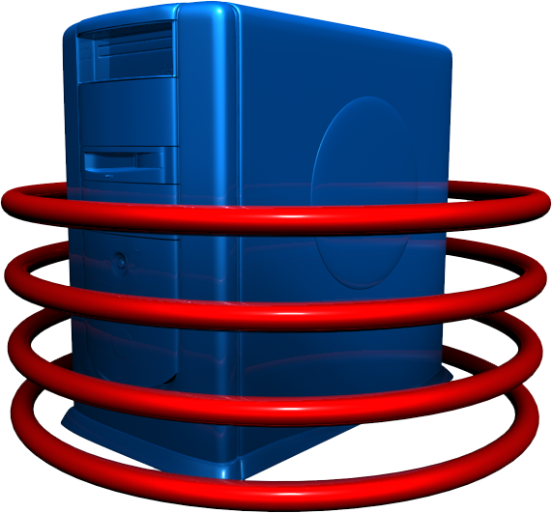

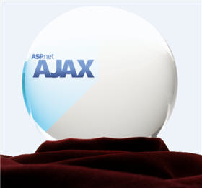
ASP.NET AJAX Server Controls

Slide 10
ASP.NET AJAX Server Controls
ASP.NET AJAX Server Controls allow easily build rich experiences with ASP.NET
Application UI and core logic still run on server
Avoid need to master the JavaScript and asynchronous programming
Use AJAX techniques to reduce full round trips
Enable incremental page UI updates
Examples: data navigation and editing, form validation, auto refresh, auto-complete, etc.

Slide 11
ScriptManager Control
<asp:ScriptManager> control
Manages:
AJAX components
Partial page rendering
Client requests and server responses on ASP.NET server pages.
Only one manager control per .aspx page
Automates the JavaScript callbacks
Required once in the page to enable AJAX

Slide 12
UpdatePanel Control
<asp:UpdatePanel> control
Easily define "updatable" regions of a page
Implements the server-side AJAX approach (partial page rendering)
Server roundtrips become asynchronous
<asp:UpdatePanel id="UpdatePanelDemo" runat="server">
<ContentTemplate>
<!-- This content can be dynamically updated !->
<asp:Calendar id="CalendarDemo" runat= "server" />
<ContentTemplate>
</asp:UpdatePanel>

Slide 13


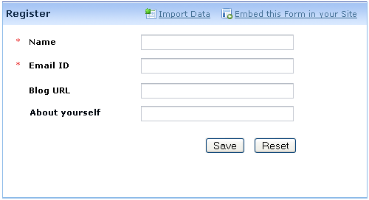

Dynamic Forms with ASP.NET AJAX
Live Demo

Slide 14
UpdatePanel.UpdateMode
UpdatePanel.UpdateMode property:
UpdateMode = Always (default)
Updates the panel for all postbacks that originate from the page (synchronous and asynchronous)
UpdateMode = Conditional
Updates the panel when something inside it is changed (by default ChildrenAsTrigger=True)
Or by calling Update() method explicitly
Or by triggers defined in the update panel

Slide 15
Triggers
Triggers cause update of the UpdatePanel’s content on particular event
Can be controls inside or outside the panel
<asp:UpdatePanel ID="UpdatePanelWithTriggers"
runat="server" UpdateMode="Conditional">
<Triggers>
<asp:AsyncPostBackTrigger
ControlID="TimerDemo" EventName="Tick" />
</Triggers>
<ContentTemplate>
</ContentTemplate>
</asp:UpdatePanel>

Slide 16
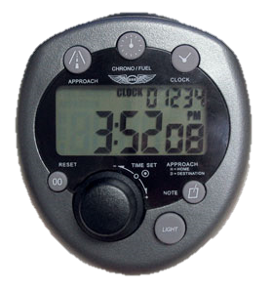
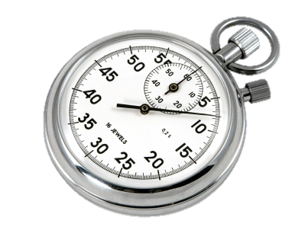
Timer Control
<asp:Timer> control
Added as a trigger of an update panel
Refreshes panel when timer interval expires
<asp:Timer ID="TimerDemo" runat="server" Interval="5000">
</asp:Timer>

Slide 17
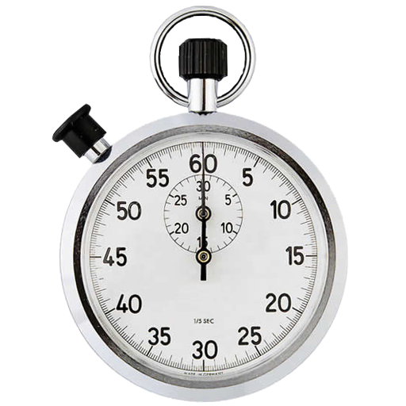

ASP.NET AJAX: UpdatePanel + Timer
Live Demo

Slide 18
UpdateProgress Control
<asp:UpdateProgress> control
Shows status while an asynchronous postback is in progress
Button to cancel the request can be added
<asp:UpdateProgress ID="UpdateProgressDemo"
runat="server">
<ProgressTemplate>
Updating ...
</ProgressTemplate>
</asp:UpdateProgress>

Slide 19
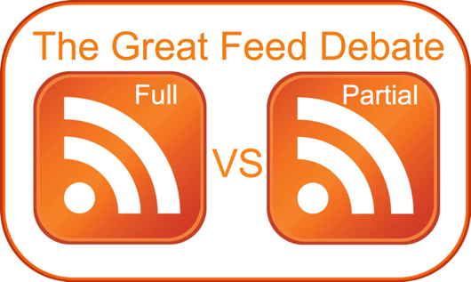

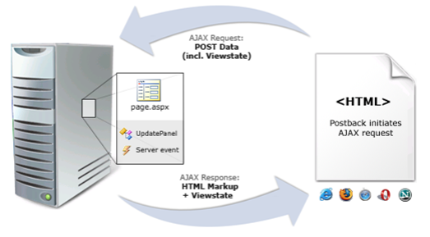


Full vs. Partial Postbacks
Live Demo

Slide 20




ASP.NET AJAX Control Toolkit

Slide 21
ASP.NET AJAX Control Toolkit
Collection of AJAX components
Ready-to-go samples
Comes with full source code and documentation
SDK to simplify the creation and re-use custom AJAX-enabled ASP.NET controls
Some controls:
CascadingDropDown – link drop-downs, with asynchronous population and no postbacks
CollaspiblePanel – panels that collapse and expand without postbacks
21

Slide 22
ASP.NET AJAX Control Toolkit (2)
ConfirmButton: extender adding a confirm dialog to any Button, LinkButton, or ImageButton control
DragPanel: makes any panel into an object that you can drag around the page
ModalPopup: shows a modal popup dialog
... and many more ...
Home Page:
http://asp.net/ajax/ajaxcontroltoolkit/
22

Slide 23
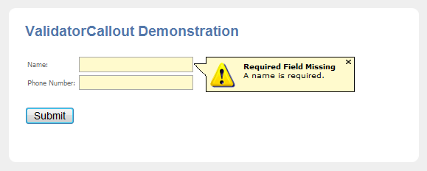
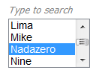
AJAX Control Toolkit
Live Demo

Slide 24


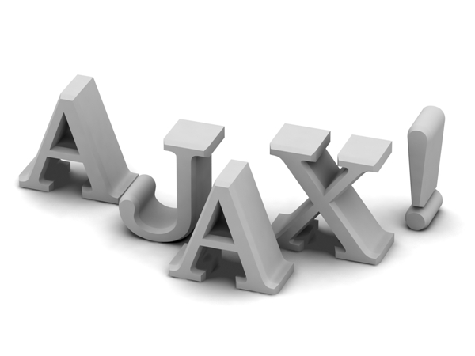
ASP.NET AJAX Basics
Questions?

Slide 25
Exercises
Create an AJAX-enabled Web site which shows Employees among and their Orders in two GridView controls (use the Northwind database and LINQ to SQL.) Put the GridView for the orders inside an update panel. Add UpdateProgress which shows an image while loading (simulate slow loading with Thread.Sleep()).
When the user selects a row in employees GridView, the UpdateProgress must be activated and the panel must be updated with the orders of the selected Employee.

Slide 26
Exercises (2)
Using Timer and UpdatePanel implement very simple Web-based chat application. Use a single database table Messages holding all chat messages. All users should see in a ListView the last 100 lines of the Messages table. Users can send new messages at any time and should see the messages posted by the others at interval of 500 milliseconds.
Using the AJAX Control Toolkit create a Web photo album showing a list of images (stored in the file system). Clicking an image should show it with bigger size in a modal popup window. The album should look like the Windows Photo Viewer.

